Slide 1
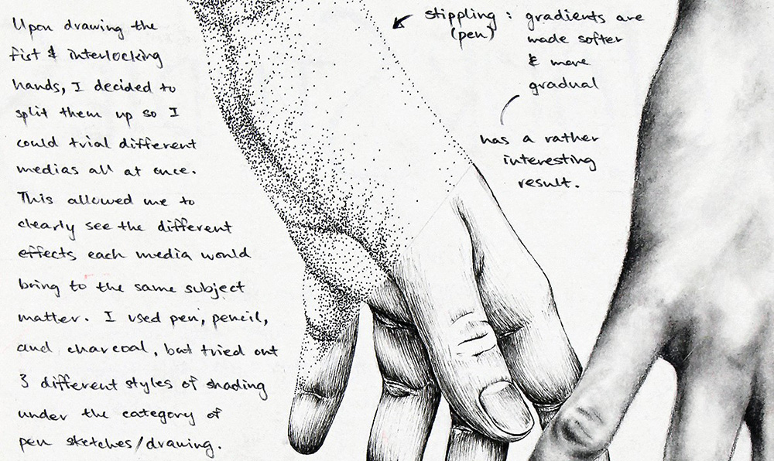
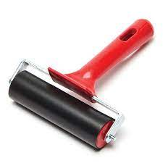
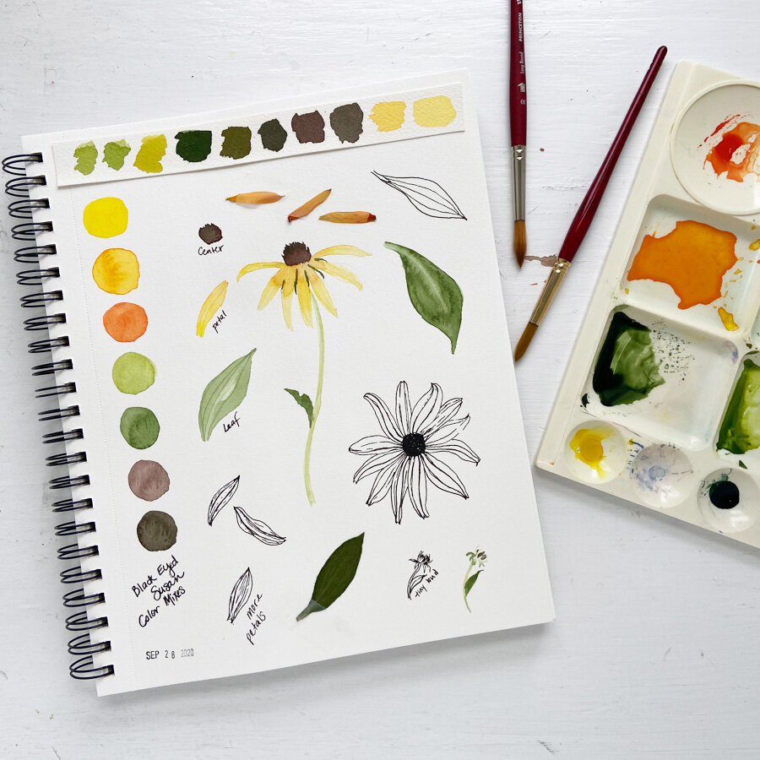
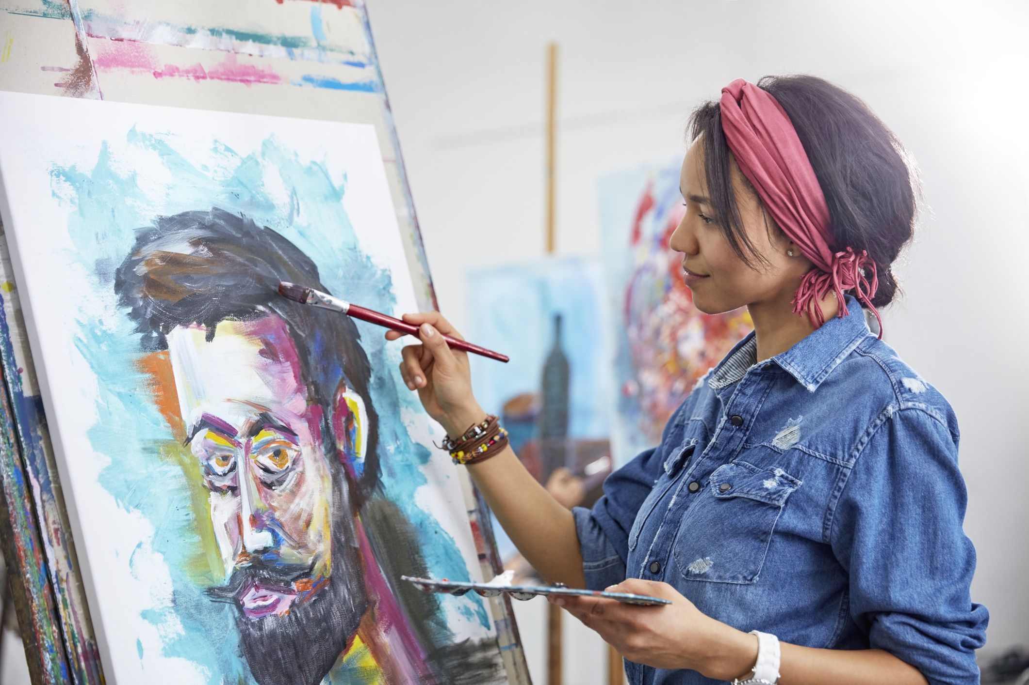
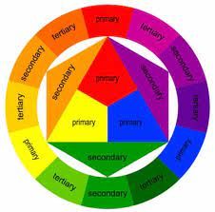
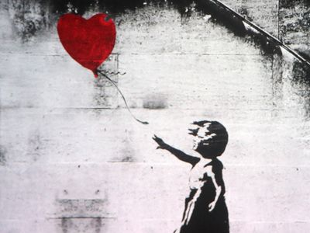
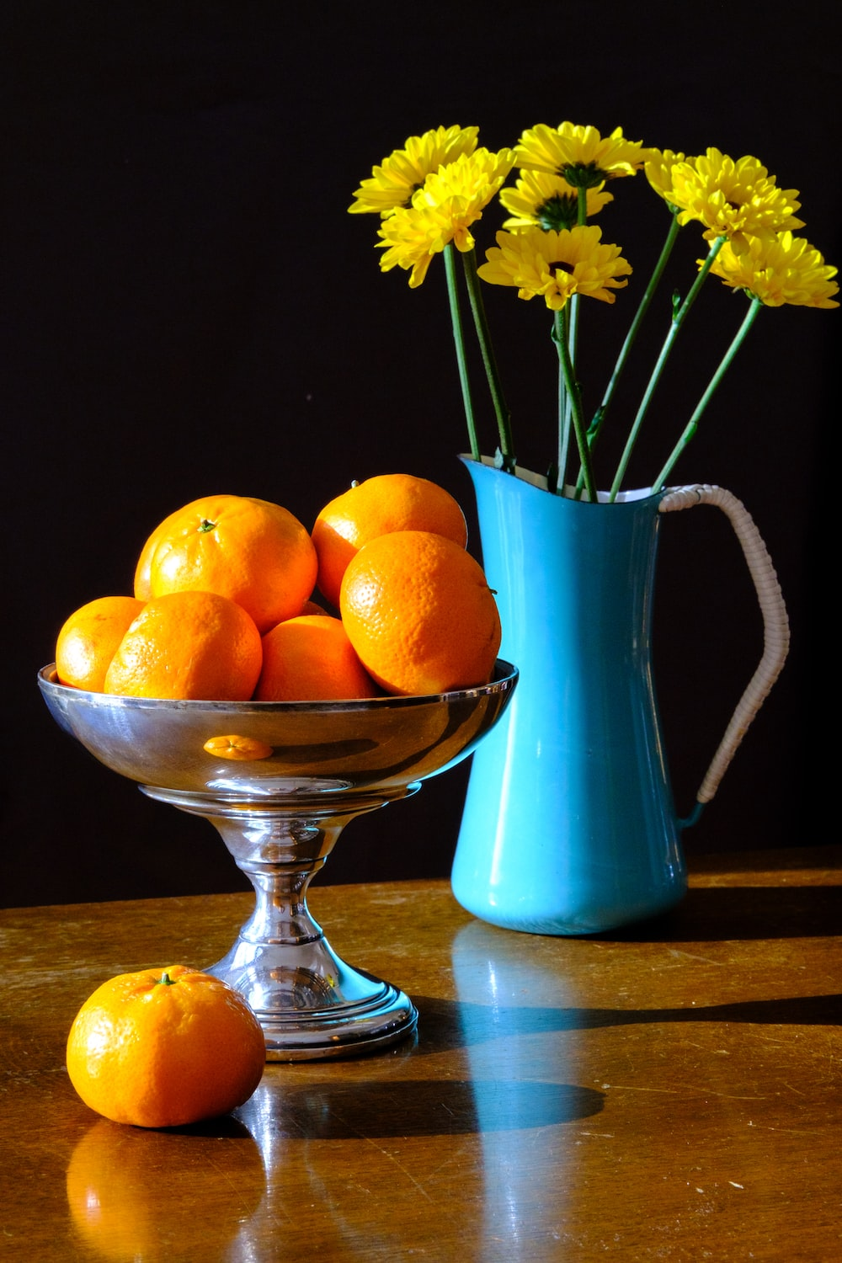
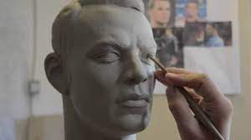
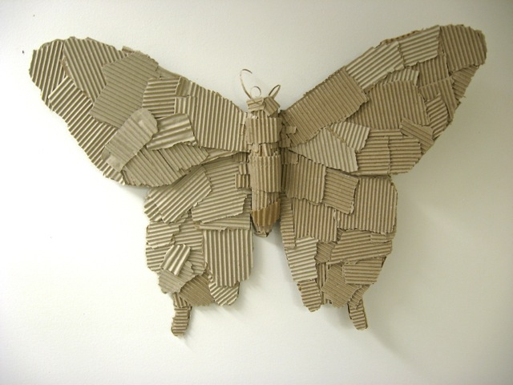
The Heights Art Curriculum Journey
boo
10 hour final Examination
Portfolio building for exam (Jan)
Annotation/writing about art recap
Print: Screen printing
Trip: College art department
KS4
Art competition
Artist research task
3D: creating sculptures from recycled materials
Recap art theory/visual elements
Mock GCSE project
Mock Exam
YEAR
11
Artist research task
Baseline skills assessment
Exploring artists/workshop
KS4
Art competition
Self/Peer Critique
Print: Lino
Gallery trip
Graffiti project
Textiles: Up-cycling
Annotation/writing about art
Print: Collagraphs
Self/Peer Critique
End of year assessment
Recap art theory/visual elements
Exploring artists/workshop
10
YEAR
Textiles: Sewing project
Baseline skills assessment
3D: Clay modelling project
KS3
Art competition
Still life: Observational drawings
Exploring artists/workshop
Baseline skills assessment
YEAR
9
3D: Creating a cardboard sculpture
Sculpture park trip
Pop Art project
Introduction to art theory/visual elements

