Slide 1
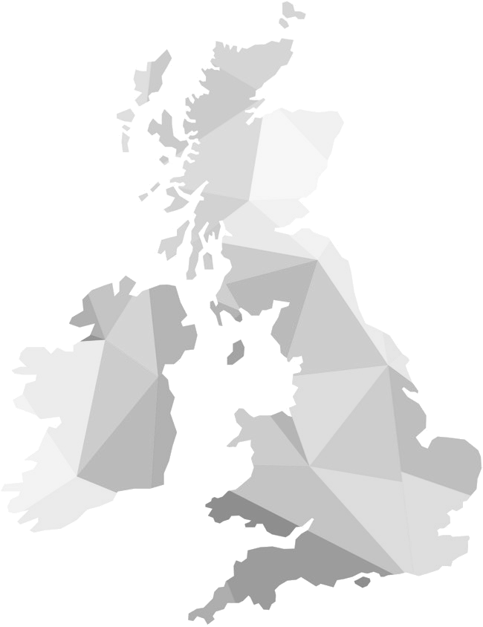
The Heights Creative Skills Curriculum Journey
Working Goals
Working Support Links
Work Placement
Identification
Work Attitudes & Behaviours
Work Placement Anxieties
YEAR
Photography Equipment & Software
11
Photography
Idea Generation
Photo
Editing
Final Project Review
Editing & Formatting
Photography
Plan & Shoot
Page Layout
Branding & Media
Safety and security practices when working online
Accessing the internet, connection methods
YEAR
10
Publication Page Layouts
Search Engines

