Slide 1
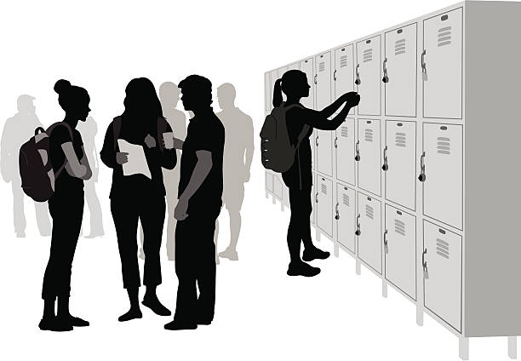
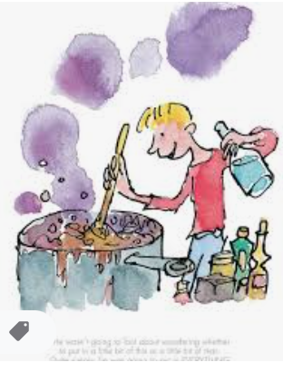
The Heights English Curriculum Journey
bookbuzz@booktrust.org.uk
GCSE Recap and revision
Rubbish Shakespeare visit
GCSEs
Bespoke revision and past papers
Identity/non-fiction writing
The reality of conflict/inner conflict
Mock exams
YEAR
Capitalism vs. socialism - An Inspector Calls
11
Theatre trip- Romeo & Juliet
Change over time/non-fiction reading
The power of nature vs. man/fiction writing
Theatre trip- An Inspector Calls
The power of love and conflict - Romeo and Juliet
Vanity and corruption/fiction reading
Social responsibility and redemption - A Christmas Carol
Theatre trip- A Christmas Carol
YEAR
10
Injustice - Ghost Boys/THUG
Half Caste, No Problem
Emmett Till/George Floyd
Bronte Museum trip
Power dynamics - A Vendetta
extracts from dystopian fiction
Individual power and identity - Jane Eyre
Sari, Caged Bird, Still I Rise, I Come from
Extracts from non-fiction
Abuse of power/Internal conflict - Macbeth and a range of poetry
Slave Trade museum visit
Remembrance Day
Theatre trip- Macbeth
Conflict - war poetry and non-fiction
WW2 museum visit
Capital Punishment
Gangs and Crime
Mental Health Mindfulness
STEM - George’s Marvellous Medicine
Conflict - Once
Transition assessment
YEAR
9
YEAR
8
Shakespeare’s tragedies
British Values/Conflict - Goodnight Mr. Tom
Global Issues - Exodus: escape to Europe
Introduction to Shakespeare
Relationships - Holes
YEAR
Our World: Summer sports
Spring World Festivals
Complete reading assessment and IDL
7
Festivals of light and dark
Cathedral Visit
Actively seek
out rewards
KS2
Seaside trip
Plant & Animal Life Cycles
Christian Festivals
Harvest
Festival

