Slide 1
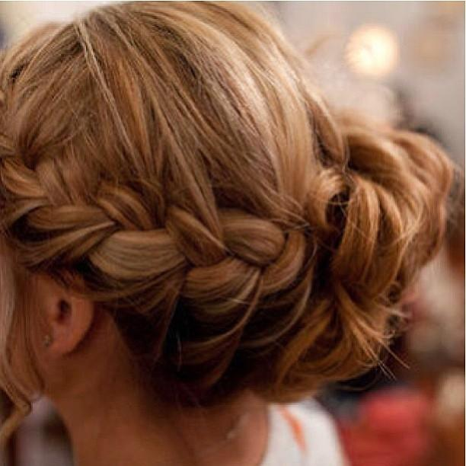
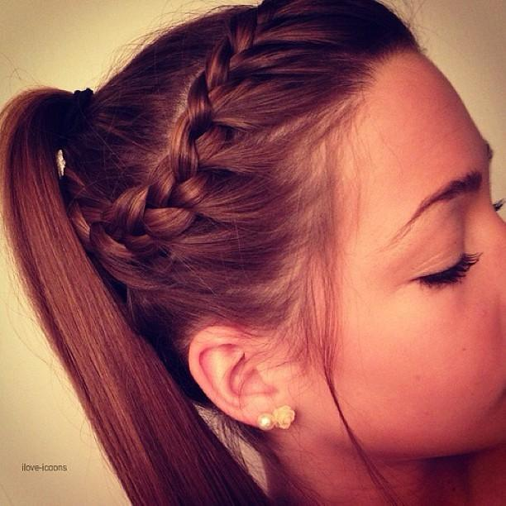
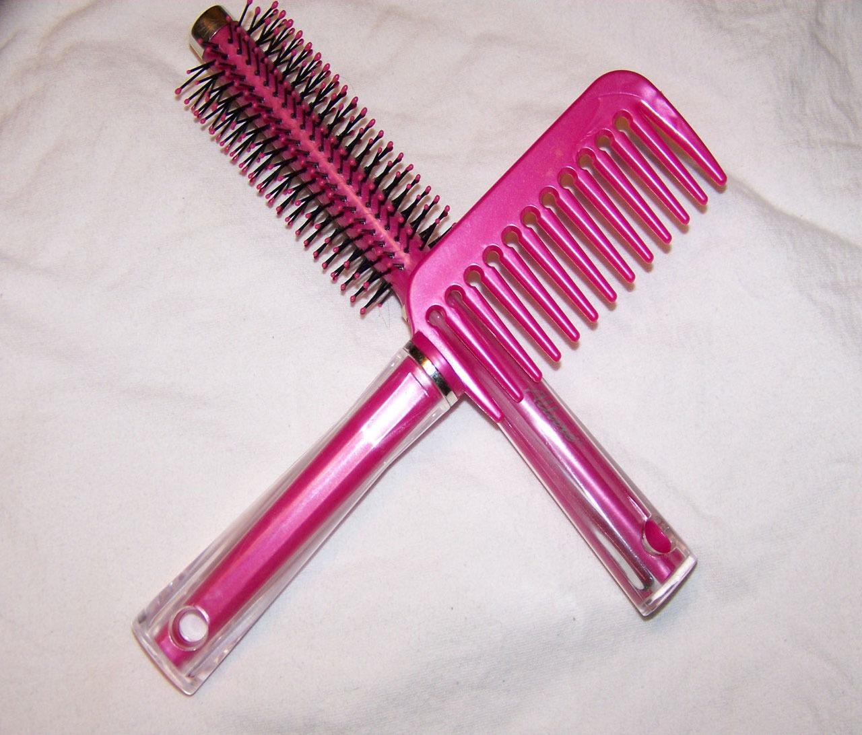
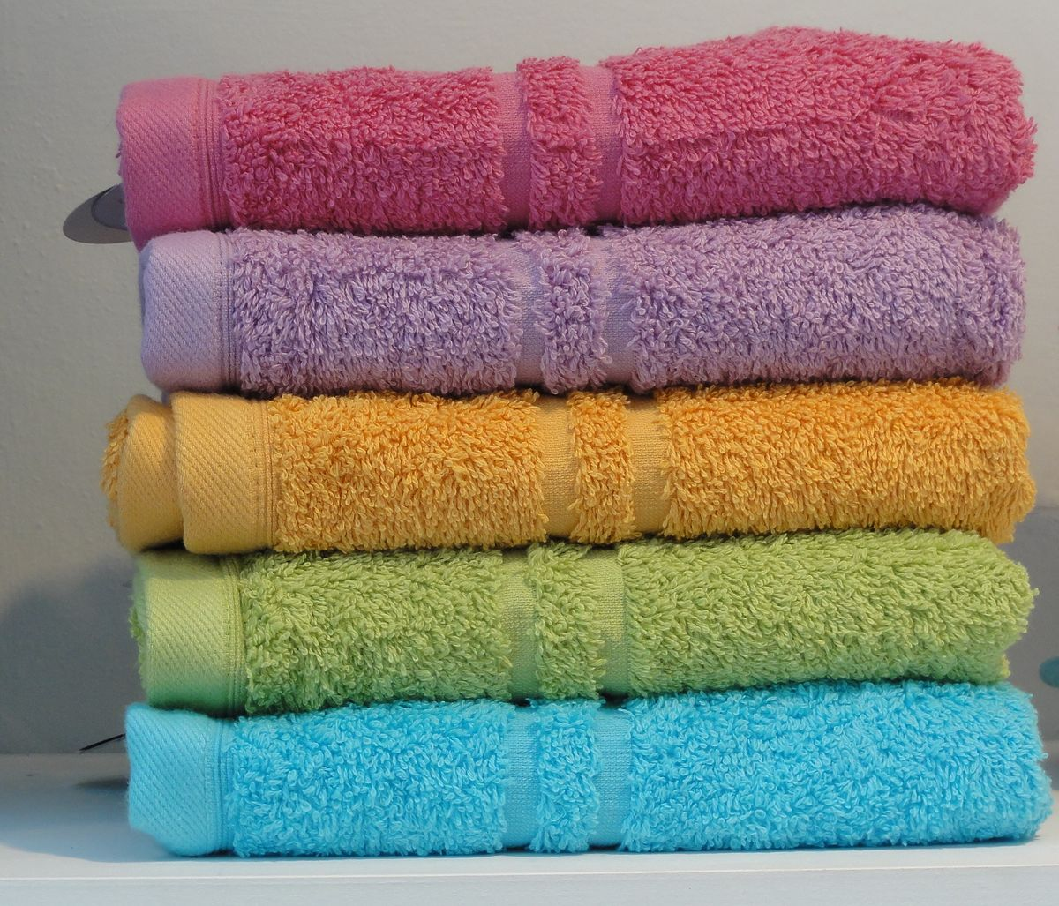
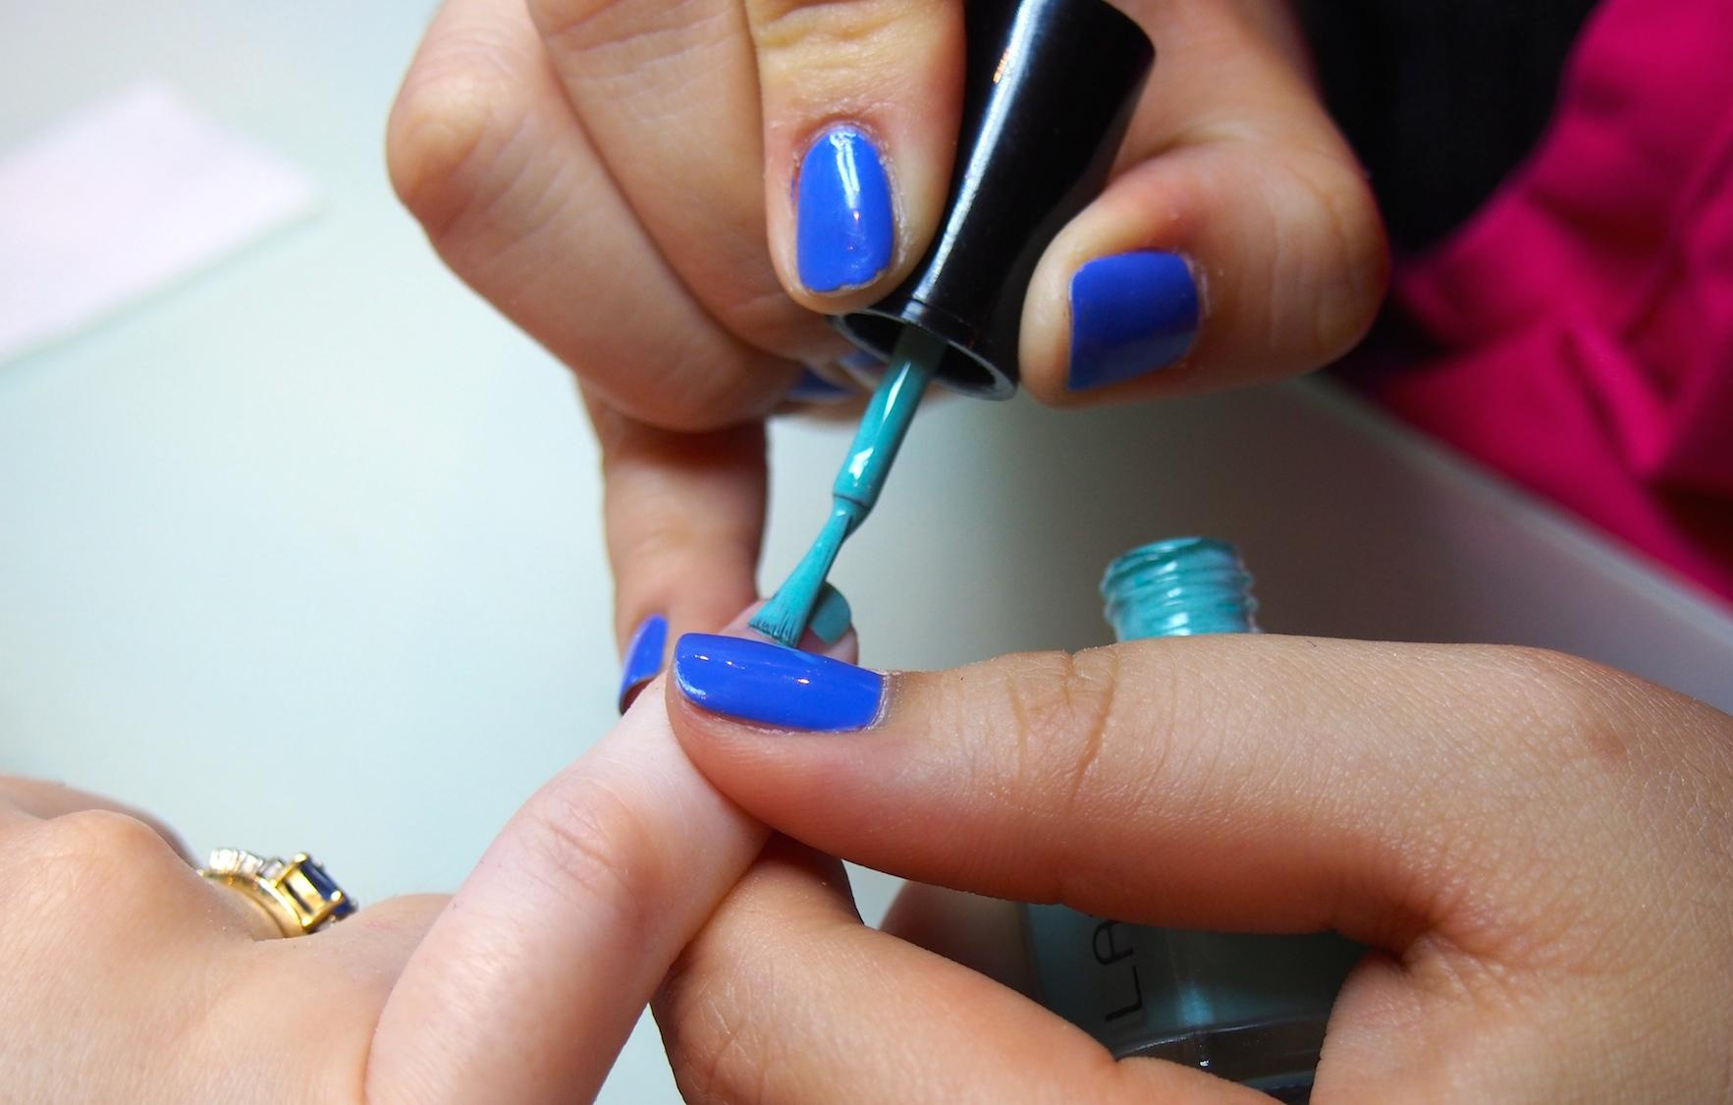
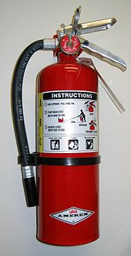
The Heights Hair and Beauty Curriculum Journey
bookbuzz@booktrust.org.uk
Create an Image Based on a Theme
Stretch and Challenge
Moodboard
Trip to the wholesalers
YEAR
Plaiting and Twisting
11
Round Brush
Fishtail Plait
Flat Twist
Gel Nails
Shampoo and Treat Hair
Basic Manicure
Flat Brush
Massage Techniques
YEAR
10
Blow Dry and Finish Hair
Hazard and Risks
Health and Safety
Trip to the
wholesalers
Legislation
Actively seek
out rewards

