Slide 1
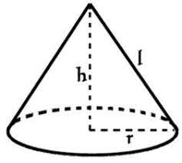
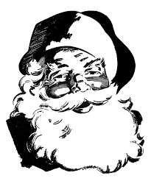
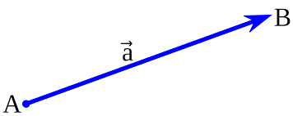
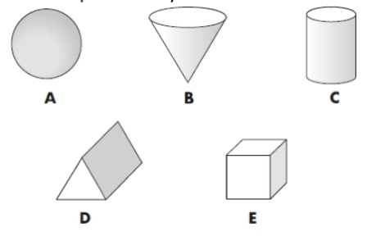
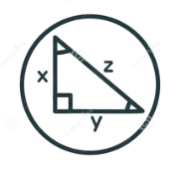
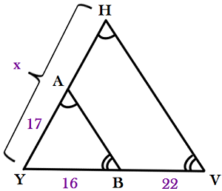
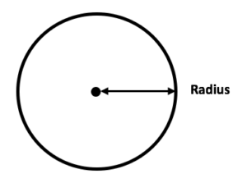
The Heights GCSE Maths Curriculum Journey
bookbuzz@booktrust.org.uk
Personalised Revision
Group revision
Mock exams
Fractions & Reciprocals
Simultaneous Equations
Circles, Cylinders, Cones & Spheres
Xmas trip
Construction, Loci & Bearings
GCSE Exams
Exam technique practice
Past Paper Exam Equations
Vectors
Quadratic Equations
Revision & Autumn Mock
Plans & Elevations
Interior & Exterior Angles of Polygons
Pythagoras
Transformations
Statistics
The Big Bang Fair at School
Properties of Shapes
YEAR
Area & Volume
11
Proportion
Multiplicative Reasoning
Trigonometry
Similarity & Congruence
Revision & Summer Mock
Inequalities
Ratio
Fractions, Decimals & Percentages
Multiples, Factors & Primes
Xmas trip
Probability
Expressions & Substitutions
Charts & Graphs
Place value
YEAR
Equations
10
Plotting
Graphs
Revision & Autumn Mock
Sequences
Indices
Real life
Graphs
Algebra
Standard Form
Probability
Prime Numbers
12/24 Clock
Algebra
Ratios
Proportion
Charts & Graphs
Multiples
& Factors
Measurements
Sequences
Perimeter & Area
The Big Bang Fair at School
Decimals
Averages
Xmas trip
BODMAS
Fractions, Decimals & Percentages
Best Value
Volume
Angle Properties
Revision & EOY Assessment
Transformations
Squares, cubes and roots
Positive & Negative integers
Substitution
2D & 3D Shapes
Rounding
Transition Period
Interpreting Charts & Graphs
Averages
Probability
Area
Four Operations
YEAR
9
Perimeter
Place value
The Big Bang Fair at School
Plotting Charts & Graphs
Roman Numerals
Ratio
Measurements
The Big Bang Fair at School
Parts of a Circle
Rounding
Fractions
Transformations
Xmas trip
12/24 Clock
Angle Properties
KS3
Place value
Four Operations
Co-ordinates
BODMAS
Angle Properties
Money
Decimals
2D & 3D
Shapes
Perimeter
Multiplication & Division
Position & Direction
Fractions
2D & 3D Shapes
Charts & Graphs
Rounding
KS2
Area
Measurement
Subtraction
Time
Counting
Place value
Multiples & Factors

