Slide 1
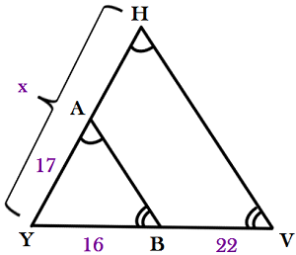
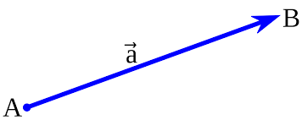
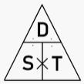
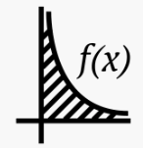
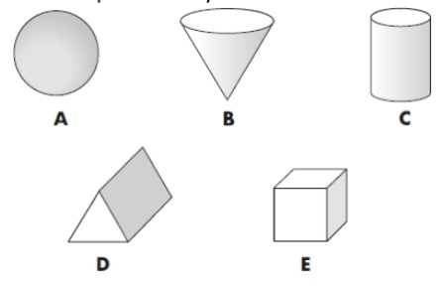
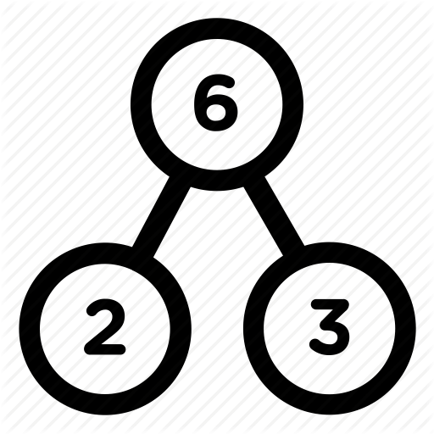
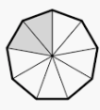
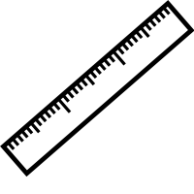
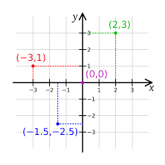
The Heights Mathematics Curriculum Journey
bookbuzz@booktrust.org.uk
Quadratic Equations
Circles,
Cylinders,
Cones & Spheres
Similarity & Congruence
Mock exams
GCSE Exams
Probability
Trigonometry
Vectors
Transformations
Simultaneous Equations
Fractions & Reciprocals
Construction, Loci & Bearings
Multiplicative Reasoning
Pythagoras
Revision & Autumn Mock
Plans &
Elevations
Statistics
Perimeter, Area & Volume
Real life
Graphs
Fractions
Equations
Sequences
YEAR
Ratio &
Proportion
11
Percentages
Inequalities
Angle Properties
Revision & Summer Mock
Properties of Shapes
Algebraic Graphs
Scatter Graphs
Multiples,
Factors &
Primes
Standard Form
Pie Charts
Tables, Charts & Graphs
Four Operations
Place Value
YEAR
10
Stem and Leaf
Expressions & Substitution
Index Laws
Decimals
Rounding and Estimating
Angle Properties
Multiples,
Factors &
Primes
Fractions and Percentages
Inequalities
Measurements
Probability
Decimals
Presenting
Data
Negative integers
Intro to Algebra
Squares, cubes and Roots
Ratios and proportion
Calculating Space
Patterns
Averages
Solving Equations
Rounding
Interpreting Charts & Graphs
Volume
Perimeter
Transformations
YEAR
Four Operations
9
Coordinates
Counting & Comparing
Plotting Charts & Graphs
Area
Percentages
Rounding
BIDMAS
Angle Properties
Fractions
Ratio
Money
KS3
Decimals
Place value
Four Operations
Solving Equations
Division
Time
Estimating
Fractions
Subtraction
Ordering
Rounding
KS2
Multiplication
Data
Addition
Negative Numbers
Comparing
Counting
Place value

